Slide 1
Shortest path problem and its application to optical network
Hongkyu Jeong, Gyu-Myoung Lee
Student ID : 20022130, 2000520
E-mail: paul@icu.ac.kr, gmlee@icu.ac.kr

Slide 2

Outline
What is shortest path algorithm?
Who is Dijkstra?
Brief introduction of Dijkstra algorithm
How to apply this algorithm to Optical Network?
Basic simulation about Shortest Path
Brief source code explanation
Future Works
Conclusion
References

Slide 3
What is shortest path algorithm?
What is shortest path?
  Definition: The problem of finding the shortest path from one vertex in a graph to another vertex. "Shortest" may be least number of edges, least total weight, etc.
What kinds of shortest path algorithms are there?
  Floyd-Warshall algorithm, Johnson's algorithm Dijkstra's algorithm, Bellman-Ford algorithm

Slide 4
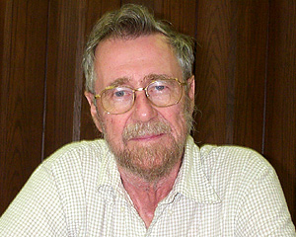
Who is Edsger Wybe Dijkstra?
Born in 1930 in Rotterdam, Netherlands, son of a chemist father and a mathematician mother
Degrees in mathematics and theoretical physics
Ph.D. in computer science from the University of Amsterdam
Worked as a programmer at Mathematisch Centrum, 1952-62
Professor of mathematics, Eindhoven Univ. of Technology, 1962-1984
Schlumberger Centennial Chair in computer sciences at Univ. of Texas at Austin, 1984-1999
Retired as Professor Emeritus in 1999
Died with cancer on 6 August 2002
1972 recipient of the ACM Turing Award, Novel prize for computing

Slide 5
Dijkstra’s Algorithm
In the table, d_{v} denotes distance from the source vertex, and p_{v} denotes previous node in the shortest path.
Priority queue is used to find the next shortest path vertex efficiently (not shown here).
Green nodes – confirmed (known),
Pink nodes – candidates,
Blue nodes – untouched.
2
2
2
v
v
d_{v}
d_{v}
p_{v}
v₁
p_{v}
v₁
v₁
v₂
v₂
v₂
v₂
v₂
v₁
v₁
0
0
0
10
v₁
4
10
4
1
1
1
3
3
v₂
v₂
∞
2
0
v₂
v₁
v₂
2
2
v₁
2
v₁
2
v₃
2
v₃
v₃
v₄
v₄
v₄
v₅
v₅
v₃
v₄
v₅
v₅
v₃
v₃
0
0
0
v₃
0
0
v₃
0
v₃
∞
3
0
v₃
3
v₄
2
v₄
2
2
8
8
4
4
5
4
5
6
6
v₄
v₄
1
∞
v₁
v₄
1
0
v₁
v₆
v₆
v₆
v₆
v₇
v₇
v₇
v₇
v₅
v₅
∞
3
0
v₅
3
v₄
1
v₄
1
1
v₆
v₆
v₆
∞
9
6
0
v₄
v₆
v₇
v₆
8
6
v₃
v₇
v₄ is confirmed (known)
Shortest path tree
v₆ is confirmed (known)
v₃ is confirmed (known)
v₂ & v₄ are explored
v₂ is confirmed (known)
v₅ is confirmed (known)
v₇ is confirmed (known)
v₇
v₇
∞
5
0
v₇
5
v₄
v₄

Slide 6
How to apply this algorithm to Optical Network?
Network Topology
Used on Routing and Wavelength Assignment (RWA)
Protection and Restoration, etc.
3
1
2
1
1
1
1
1
1
1
1
1
1
S
2
1
1
2
D
1
1
1
1
1
1
1
2
1
2
2

Slide 7
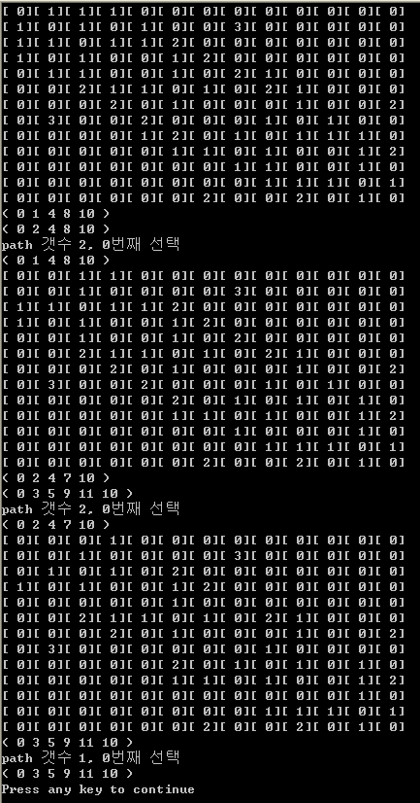
Basic simulation about Shortest Path
Find three disjoint shortest path from a source to destination
Take Topology
Find Shortest paths
Choose first shortest path
Find disjointed Shortest paths
Choose second shortest path
Find disjointed Shortest paths
Choose third shortest path

Slide 8
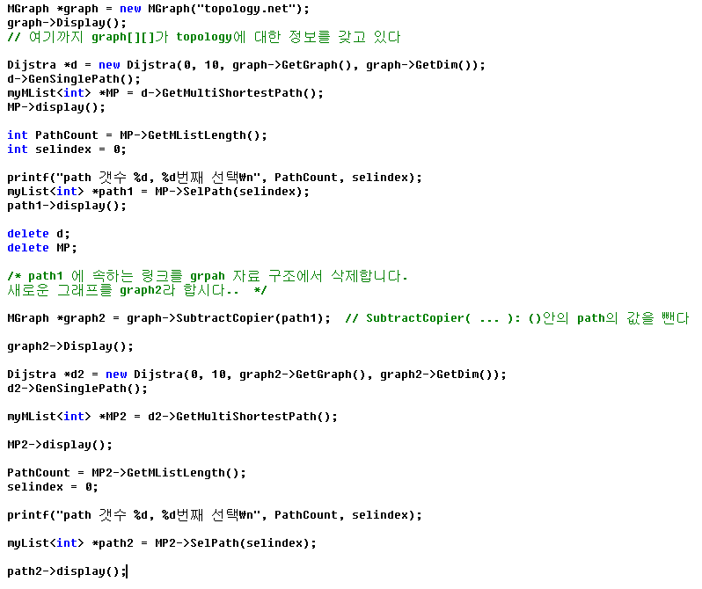
Brief source code explanation

Slide 9
Future works
Apply this algorithm to protection algorithm
  Shortest path algorithm is used to find disjoint paths for working path and backup path
  Make the Data Base which contain the information about paths, wavelength capacity, etc.
  To achieve high sharing rate of backup path by use same wavelength for the efficiency of network through the comparison of backup paths which have disjoint working path each other
  Get the simulation results such as the number of totally used wavelength, call request blocking rate, etc
At the next presentation…We will show you
  the mechanism of our idea how to adapt shortest path algorithm to optical network
  the graph of results mentioned above

Slide 10

Conclusion
About Shortest path and Dijkstra
Usefulness of Shortest path algorithm in the optical network
Proposed simple shortest path simulation to find three disjoint paths
We will use shortest path algorithm as a base concept for protection & restoration in optical network
Until next presentation.. We will develop the contents that are mentioned before

Slide 11
References
[1] Discrete mathematics and its applications, 5th ed.
[2] http://www.cs.utexas.edu/home/news/articles/index2002
/ewdobit.html
[3] http://www-unix.mcs.anl.gov/dbpp/text/node35.html
[4] http://www.nist.gov/dads/HTML/shortestpath.html
[5] http://www.orie.cornell.edu/~or115/handouts/handout3
/handout3.html

Slide 12

Thank you !
Q & A

